Slide 1
GDP I FINAL PRESENTATION
PROJECT MANAGEMENT COLLABORATION TOOL
Team D : Phoenix
TEAM MEMBERS:
Anudeep Reddy Mallidi
Hemanth Sai Kishore Nersu
Sanjay Bedudoori
Shravani Alampalli
Sudharshan Reddy Kankara
Venkata Bhardwaj Avasarala
Vineeth Gajula

Slide 2

Client and Mentor
Client & Mentor: Dr. Michael Oudshoorn
Associate professor in the School of Computer Science and Information System

Slide 3
Contents
Introduction
Requirements
Project Prototypes
Use cases
Project management plan
Tools and Technologies
Challenges faced and lessons learned
Demo
Conclusion

Slide 4
Introduction
Collaboration Tools: Collaboration is a joint effort of multiple individuals or work groups to accomplish a task or project. Within an organization, collaboration typically involves the ability of two or more people to view and contribute to documents or other content over a network.

Slide 5
Problem
Most of the tools are failed to provide all the functions in a single tool. Like Skype is unable to provide a editable tool for all the team. Similarly, many tools have different problems.

Slide 6
Solution…
Collaborating all functions in a single tool for business purpose and other activities is basic need in IT industries and also in some more places like schools, hospitals and so on. Which satisfies users to collaborate with others.
System should accommodate all the mentioned requirements by the client and should produce the desired output as per the use cases.

Slide 7
Requirements
User should able to sign-up/sign in the login page. Which enables user to create an account in project management collaboration tool.
User should able to create/join a group.
Team can share a calendar where they can schedule meetings.
User will able to chat in groups.
Team members can assign team roles to create task and assign task automatically or manually.
Team members can be able to edit documents.
Allow users to invite others to view, download and collaborate on all the files.

Slide 8
Requirements (Contd..)
User should provide below details:
User should provide credentials in order to access the collaboration tool.
User should create a team or join a team.
Different roles should be given in order to give permission.

Slide 9

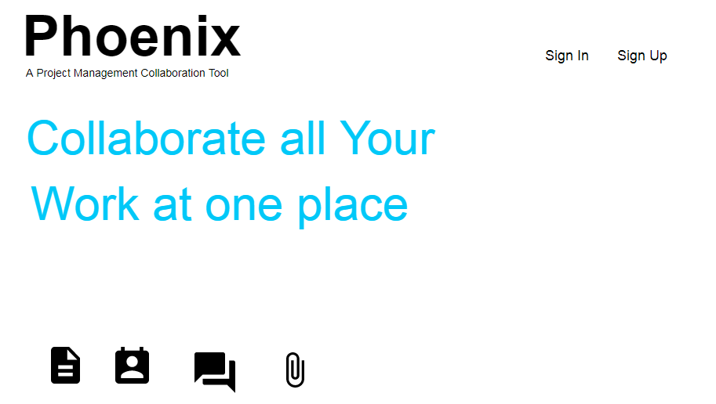
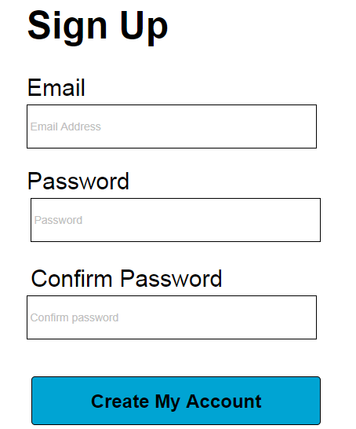
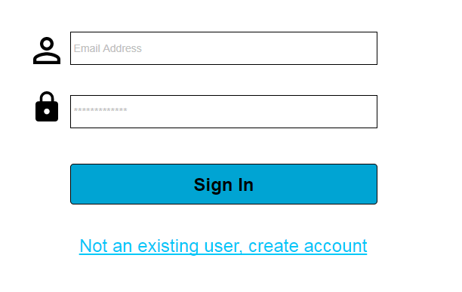
Project Prototypes
User initially need to create account with email address and password.

Slide 10
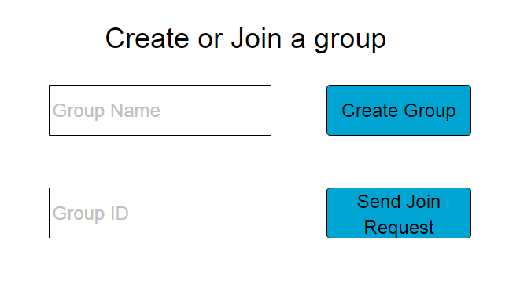
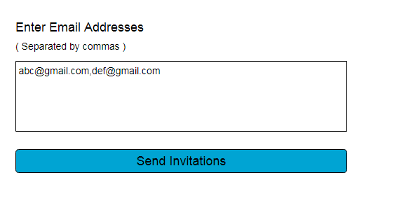
Project Prototypes(contd..)
Users just need to create a team or join a team
User just click the create button and can form a team
Can invite team members by sending invitations

Slide 11
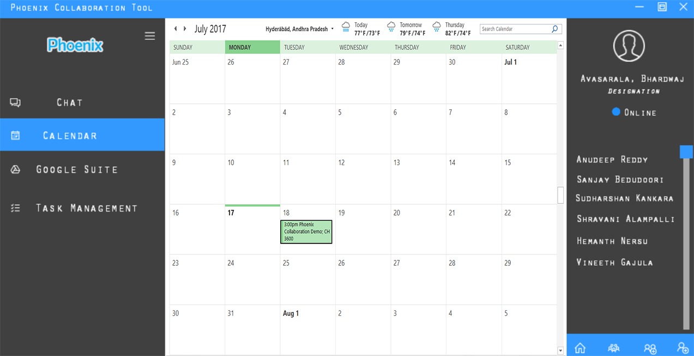
Project Prototypes(contd..)
Users can share calendars, can share docs by giving credentials and forming team mentioned in the previous slides.

Slide 12
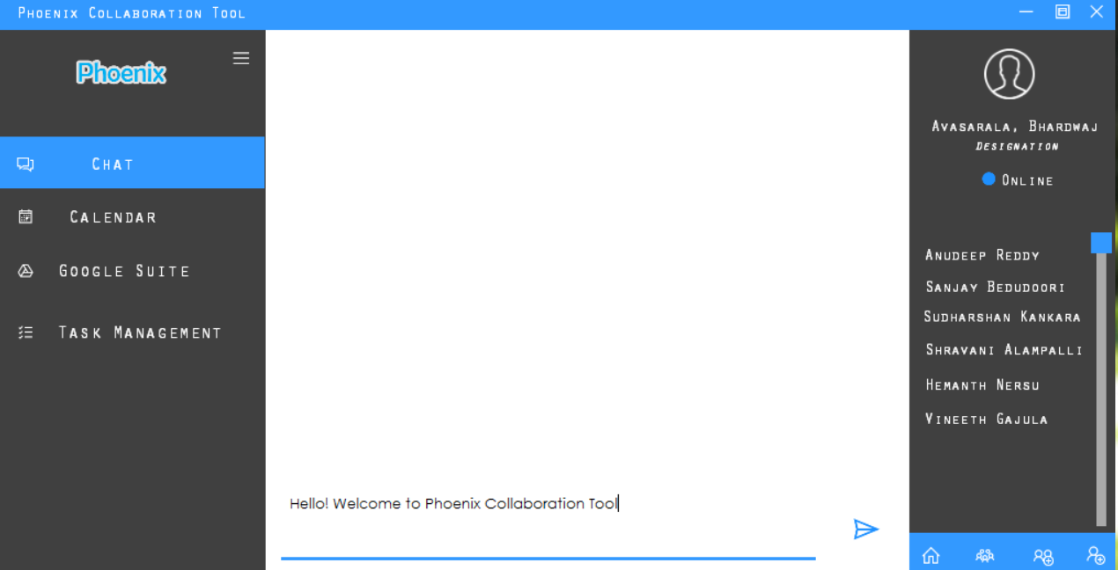
Project Prototypes (Contd ..)

Slide 13
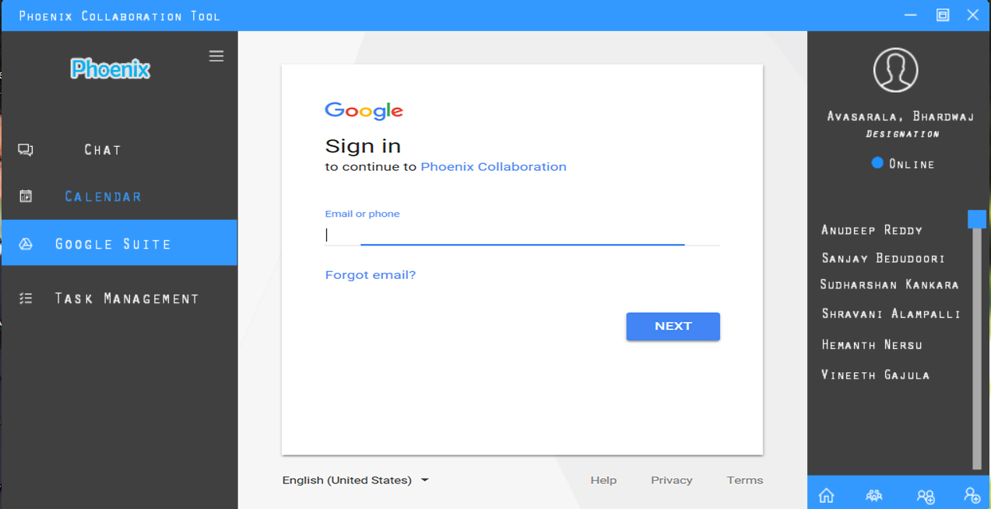
Project Prototypes (Contd ..)

Slide 14
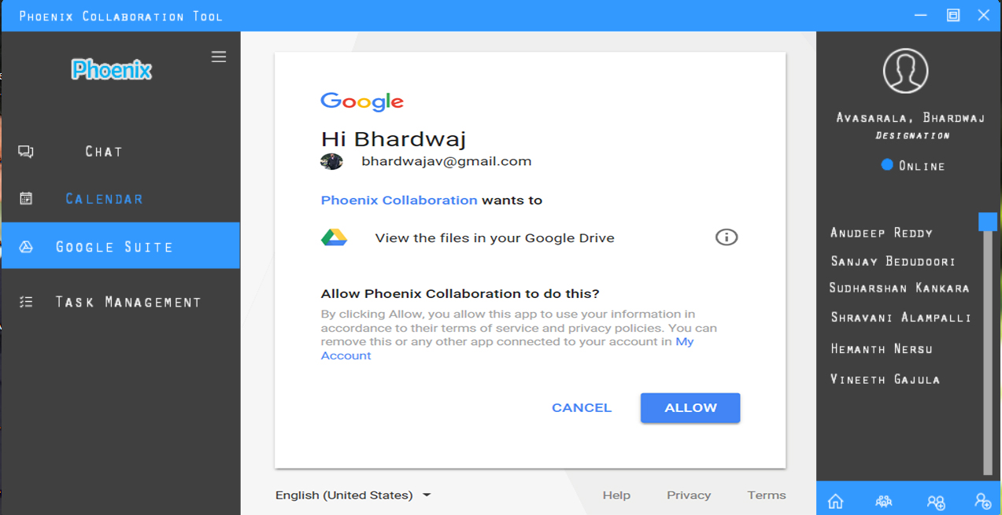
Project Prototypes (Contd ..)

Slide 15
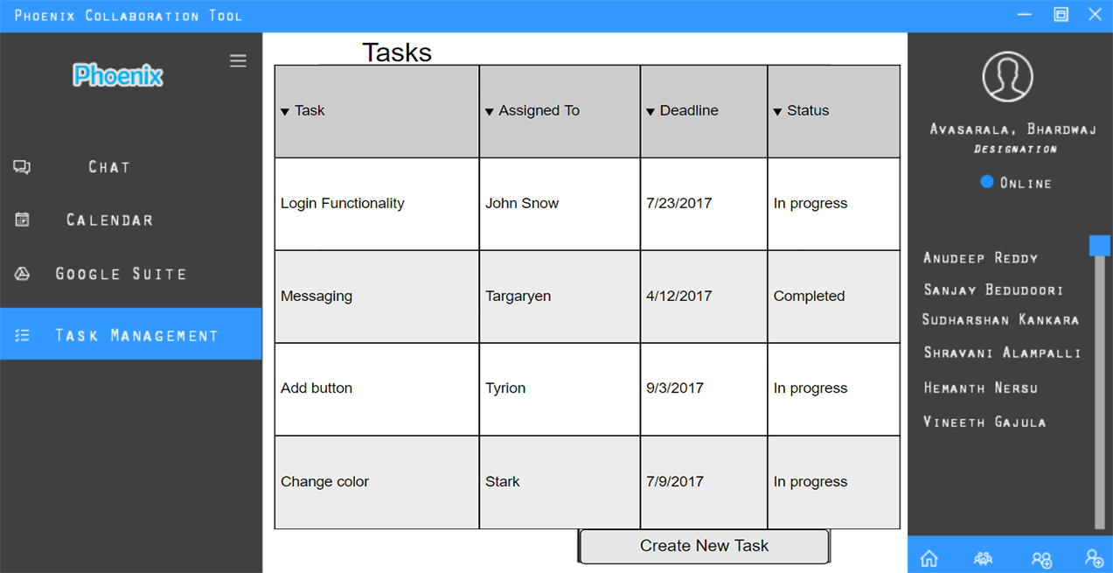
Project prototypes (Contd..)

Slide 16
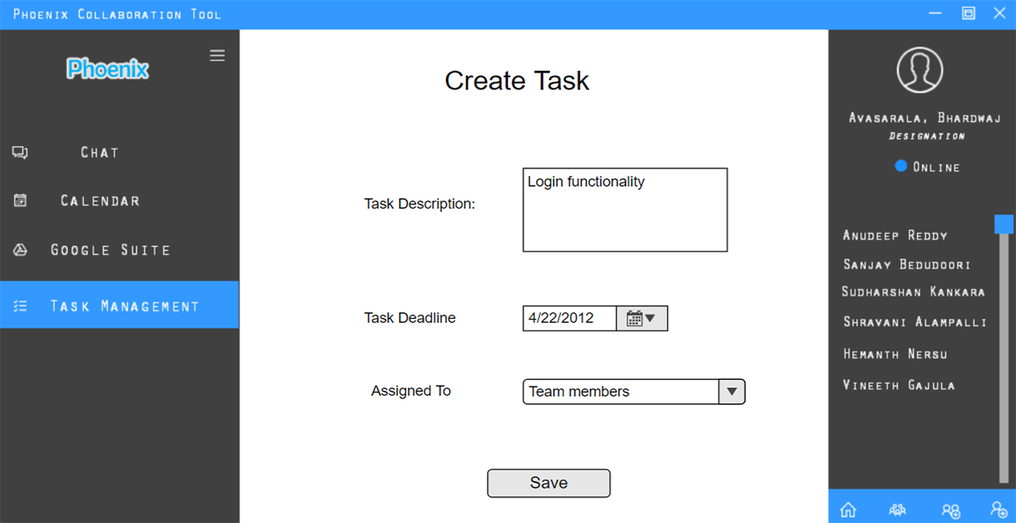
Project Prototypes (Contd ..)

Slide 17
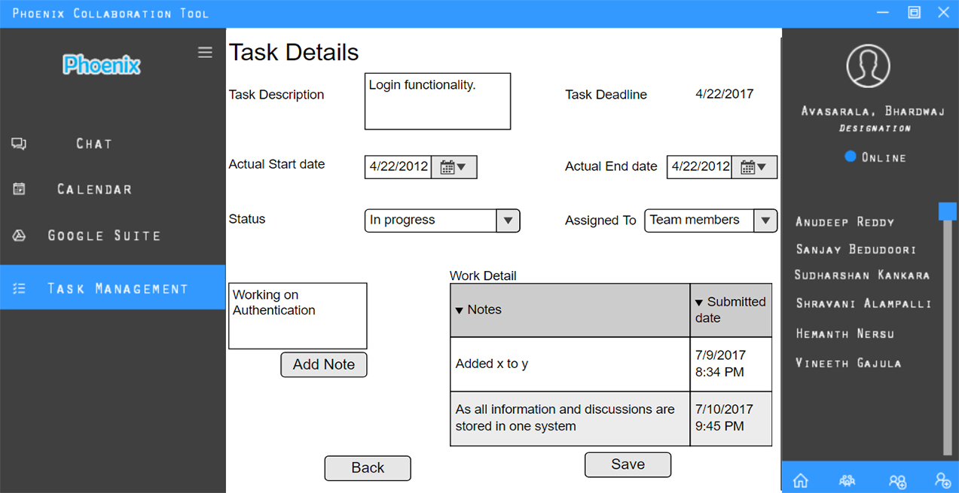
Project prototypes (Contd ..)

Slide 18
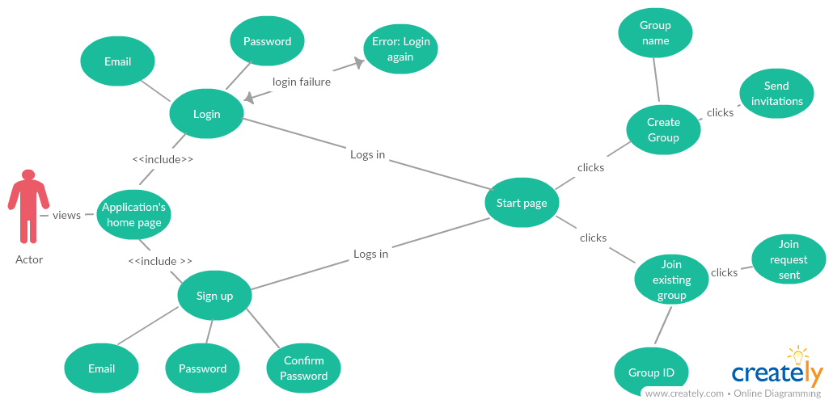
Use cases
Login, sign up and group creation

Slide 19
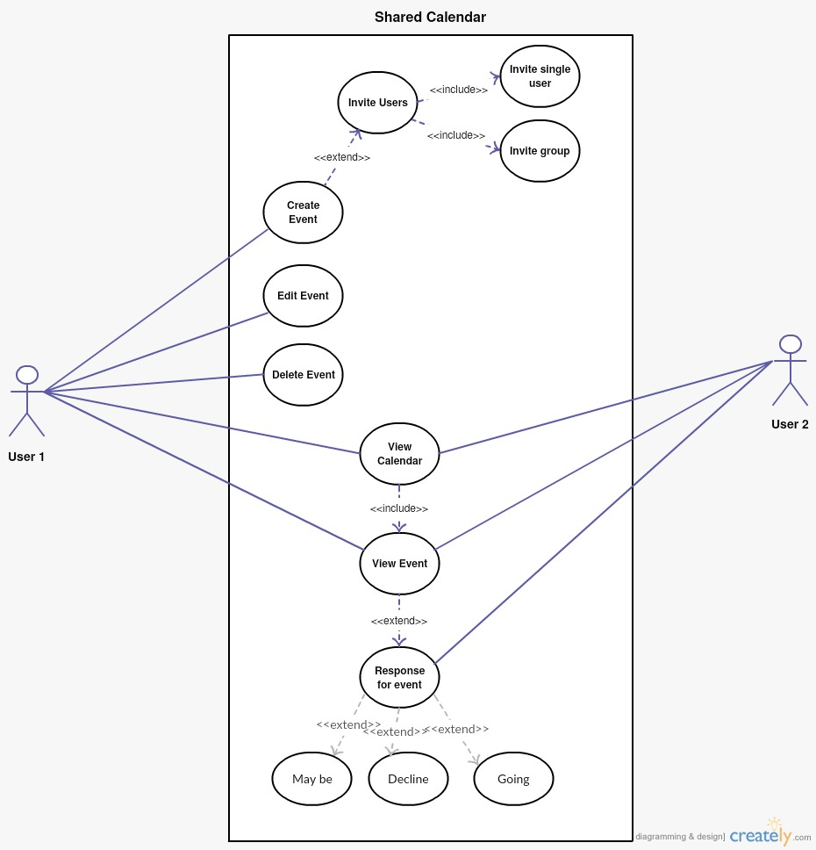
Use Cases
Use case for shared calendar.

Slide 20
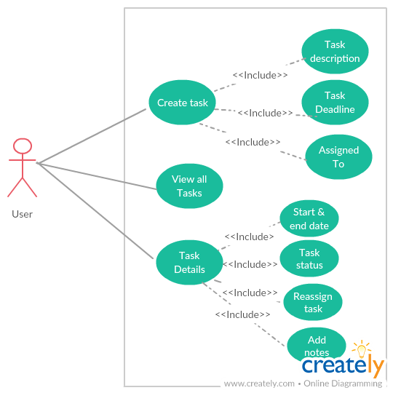
Use Cases(contd..)
Use case for task Management.

Slide 21
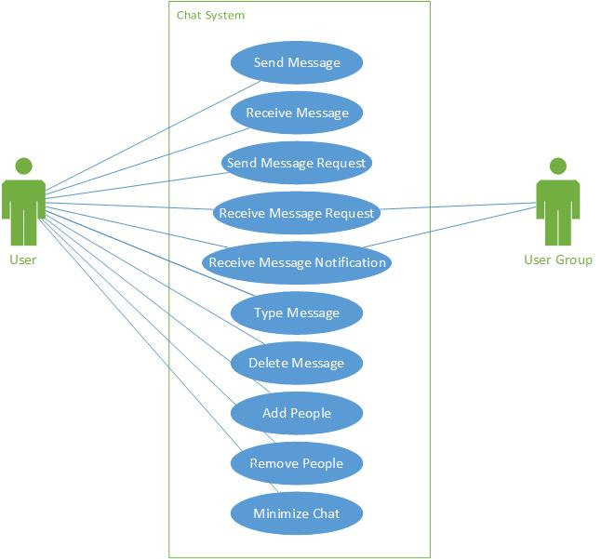
Use Cases(contd..)
Use case for chat application.

Slide 22
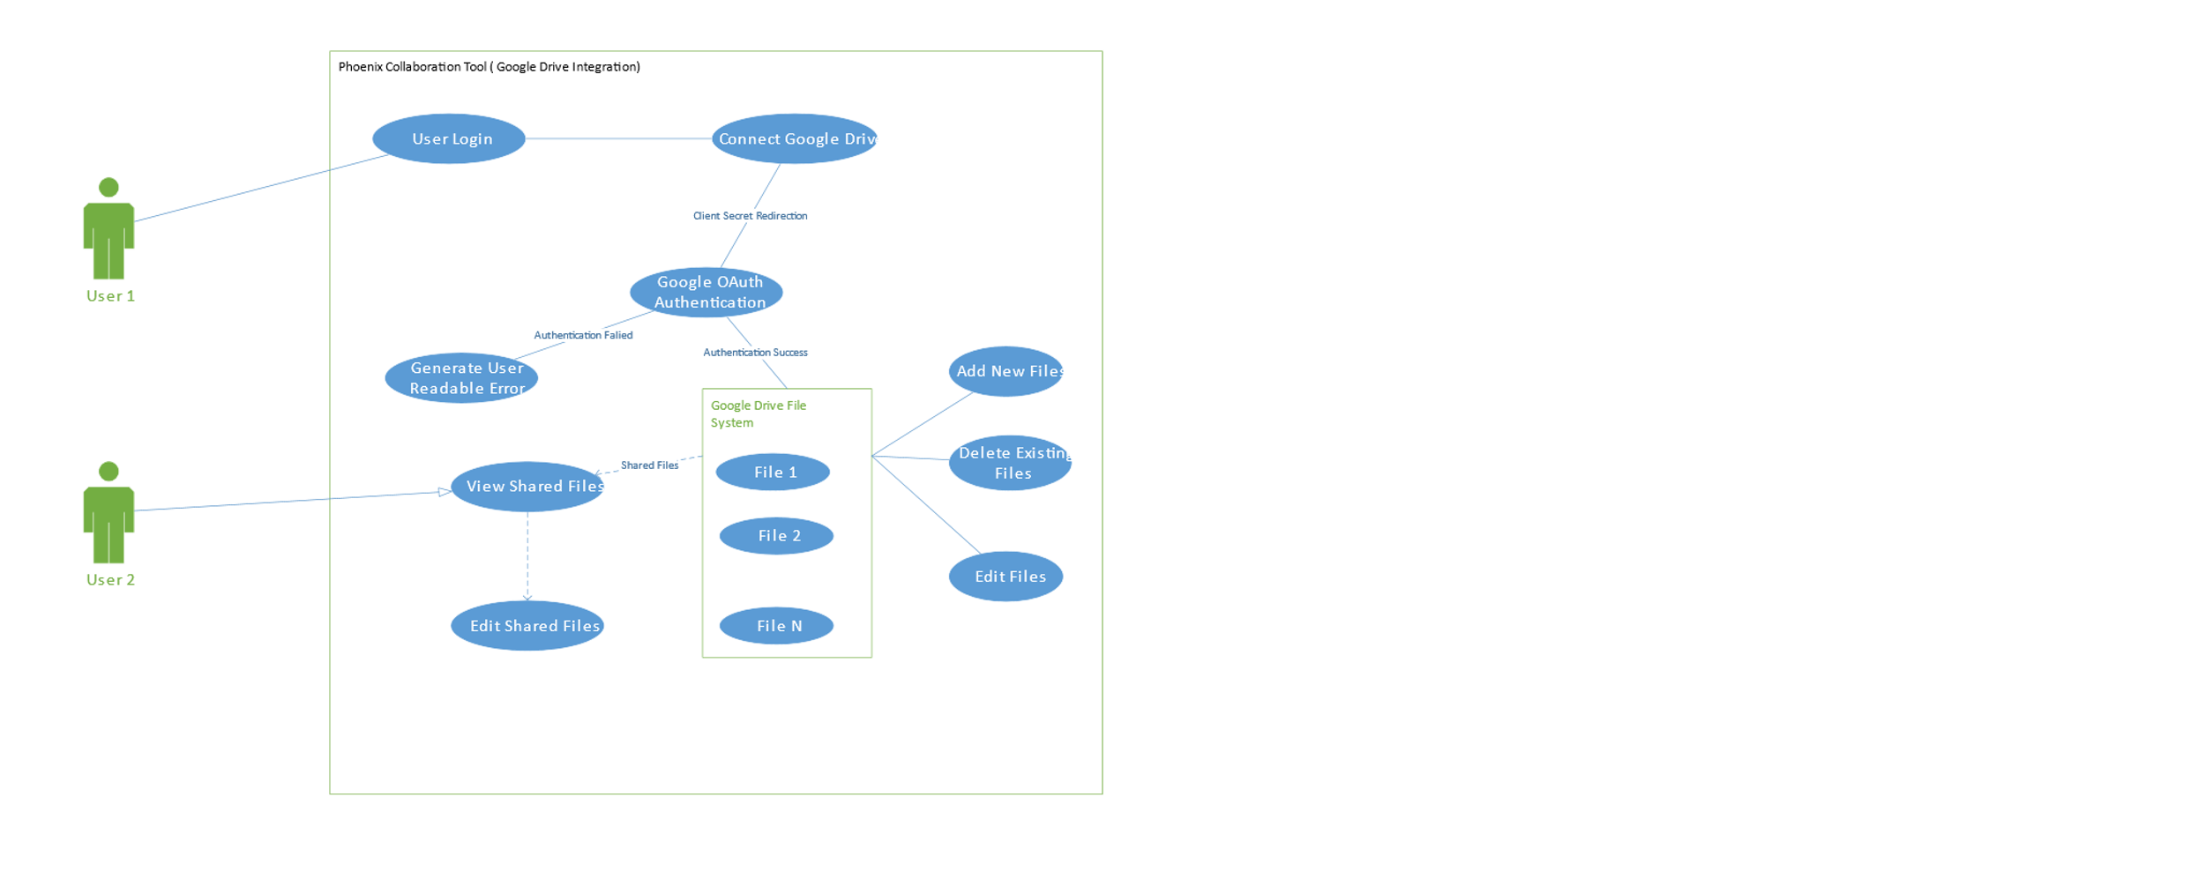
Use Cases(contd..)
Use case for google drive integration.

Slide 23
Project Management Plan
Budget Allocation: We estimated budget based on the effort and time spent on the project by our team. In GDP I, each and every member of team spent 5 hours on project in weekdays and in weekends we had team meetings of 2 hours duration and work for 7 hours on project. We will be having classes on weekdays for 2 hours where we meet the client also. There will be one change in GDP II i.e. each and every team member will spend for 2 hours in weekdays.
GDP I GDP II
Weekdays: 5 X 5 = 25 5 X 2 = 10
Weekend team meetings: 2 X 1 = 2 2 X 2 = 4
Weekends: 2 X 7 = 14 0 hours
Client meetings: 1 X 1 = 1 1 X 1 = 1
Total: 42 hours 15 hours

Slide 24
Project Management Plan(contd..)
So we are spending about 42 hours in GDP I and 15 hours in GDP II per person per week which makes a total of 42X7 = 294(In GDP I) and 15X7 = 105(In GDP II)hours per week per team. So the total budget of the project is = 294 X 6 + 105 X 14 = 3234 hours.
GDP I GDP II
Per week per person: 42 X 1 = 42 15 X 1 = 15
Per week per team: 42 X 7 = 294 15 X 7 = 105
Total hours per team: 294 X 6 = 1764 105 X 14 = 1470
Here 20 is the total number of weeks the project is going to take.

Slide 25
Project Management Plan(contd..)
Estimation of number of lines of code: Our estimation for these project would be 7000 lines of code(approximately). Estimated these 7000 count from the research on the existing system and some of the friends working for these tools and also employees working on these tools.
On an averagely, a person should write 75 lines of code per week in our GDP II.
For which a person needs to work for 10 hours and also need to attend team meetings of 5 hours in a week.

Slide 26
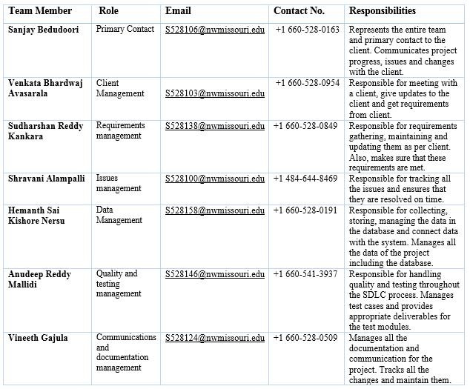
Project Management Plan(contd..)
Schedule: The project started on 06/12/17 and it will be completed by 12/15/17.

Slide 27
Tools and Technologies
Github
Chrome
Google drive
Visual Studio
MS Project

Slide 28
Challenges Faced
Different point-of-views for each of the team member.
Lack of communication in team members and also with client.
Changes in requirements.
Distribution of work.
Lack of technical skills.
Limited knowledge in existing system.

Slide 29
Lessons Learned
Motivation is necessary
No motivation leads to disinterested team
Collective Responsibility
Project is the responsibility of all the members
Tools and techniques - Project Management
How tools assist in project management
Time Management
Everyone of the team worked on time.

Slide 30
GDP-1 Deliverables
Requirements Document
Test Plan & Test Suite
Use Cases
Software Prototype
Software Architecture
Project Management Plan
User Manual & Installation Guide

Slide 31
Demo….

Slide 32
Conclusion
Completed requirement document
Need approval from client
Hope all the changes are updated, even if any changes are their in the requirements, will update those and submit it
Be ready to start coding.

Slide 33
Thank you !!!
Any queries???

